Slide 1
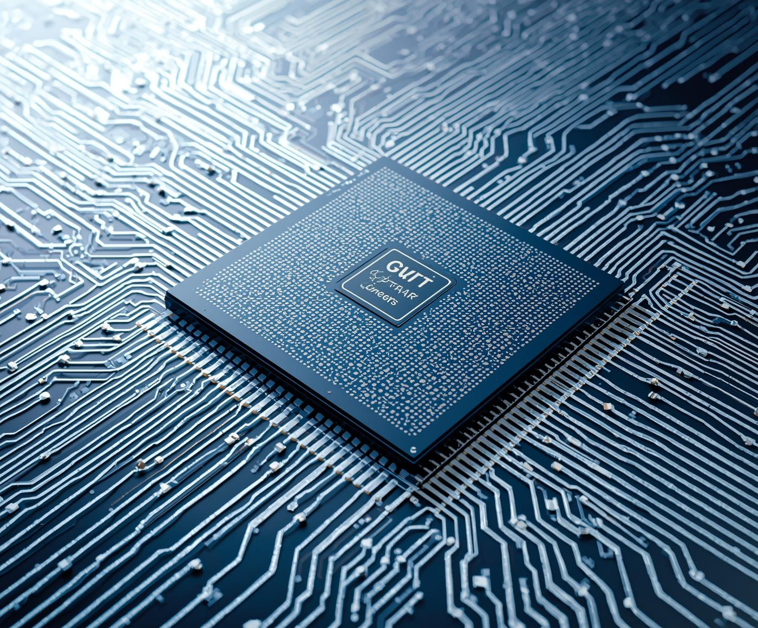
The CPU
Hana Aden
SEOFCH ACEDAMY

Slide 2
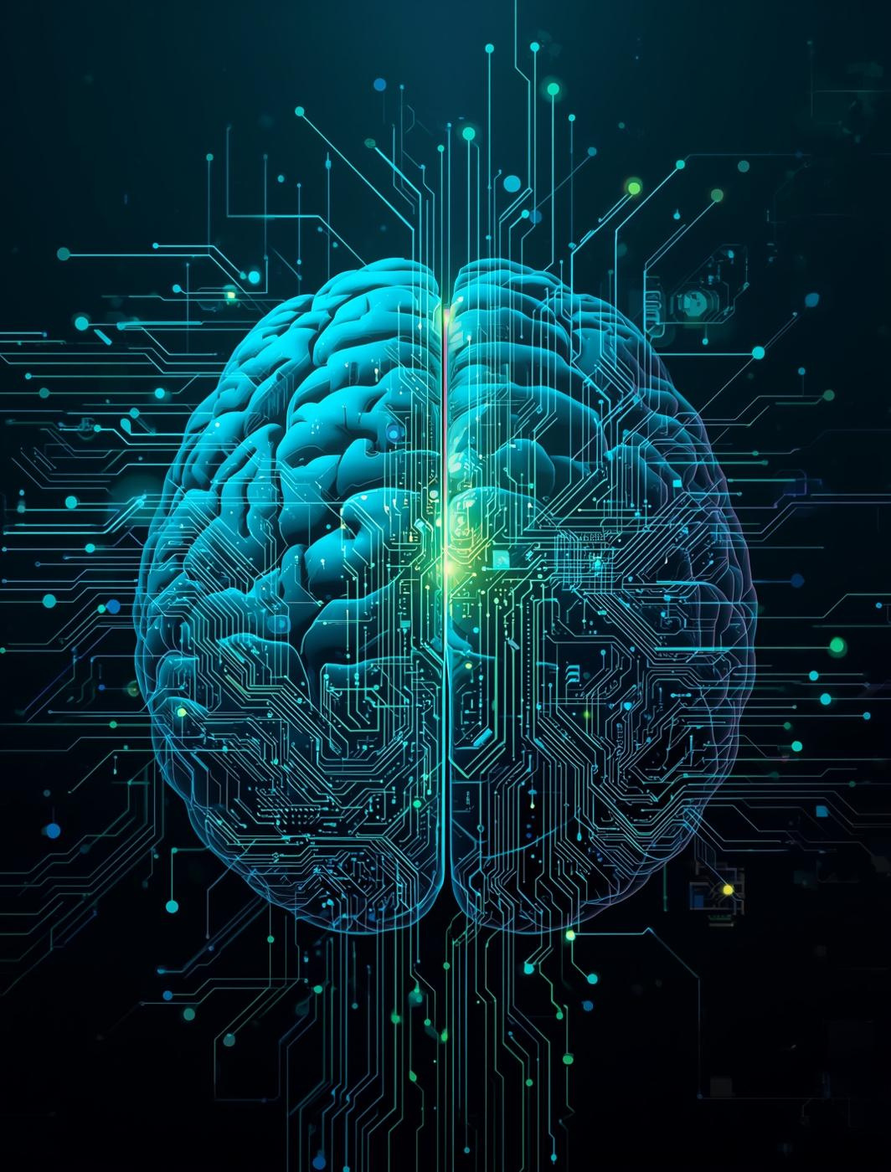
The CPU: The Brain
Understanding the Central Processing Unit's Role in Computers
The Central Processing Unit (CPU) is often referred to as the brain of the computer, responsible for executing instructions and processing data. It manages programs, applications, and operating system tasks. Without a CPU, a computer cannot function, making it a crucial component in any computing device.

Slide 3
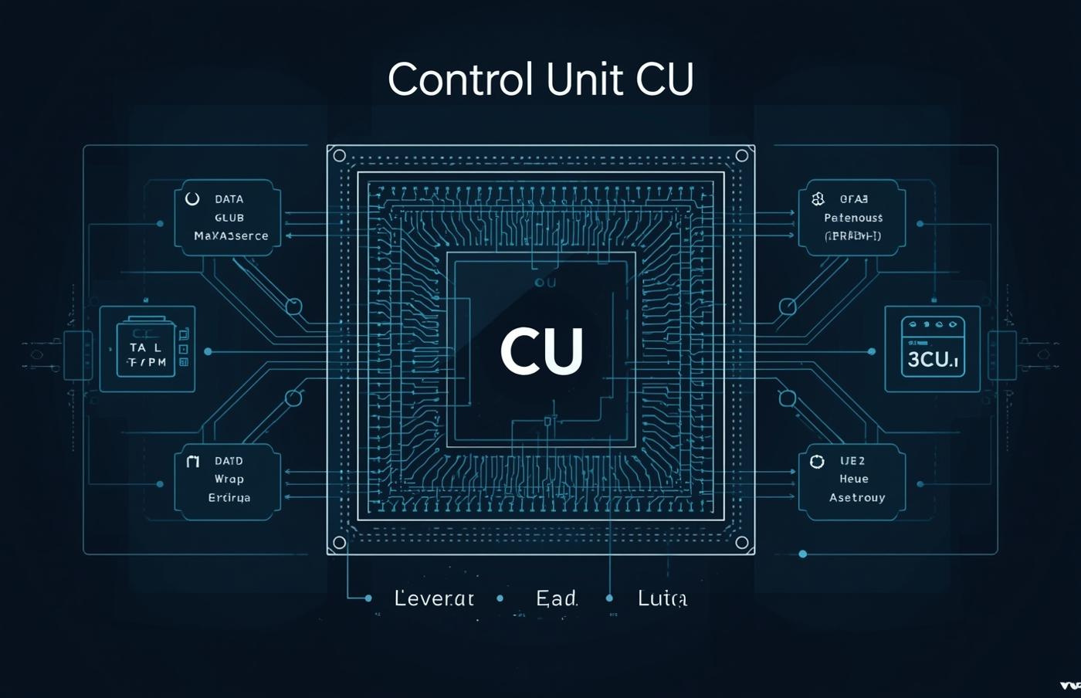
Parts of the CPU: Control Unit (CU)
Control Unit
The CU directs data flow between CPU components efficiently.

Slide 4
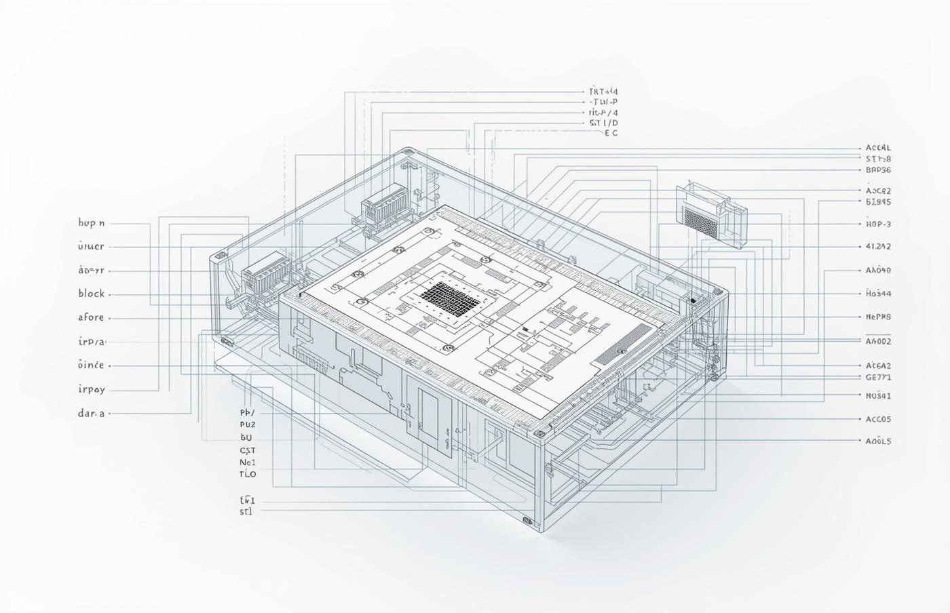
Parts of the CPU: Arithmetic Logic Unit (ALU)
Arithmetic Logic Unit
The ALU performs essential calculations and logical operations.

Slide 5
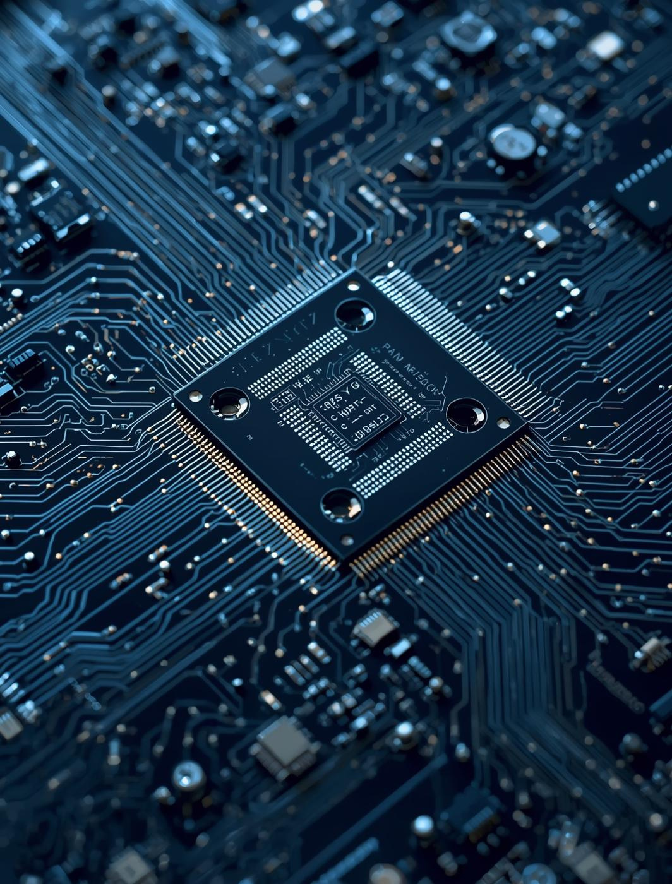
Visualizing the CU and ALU

Slide 6
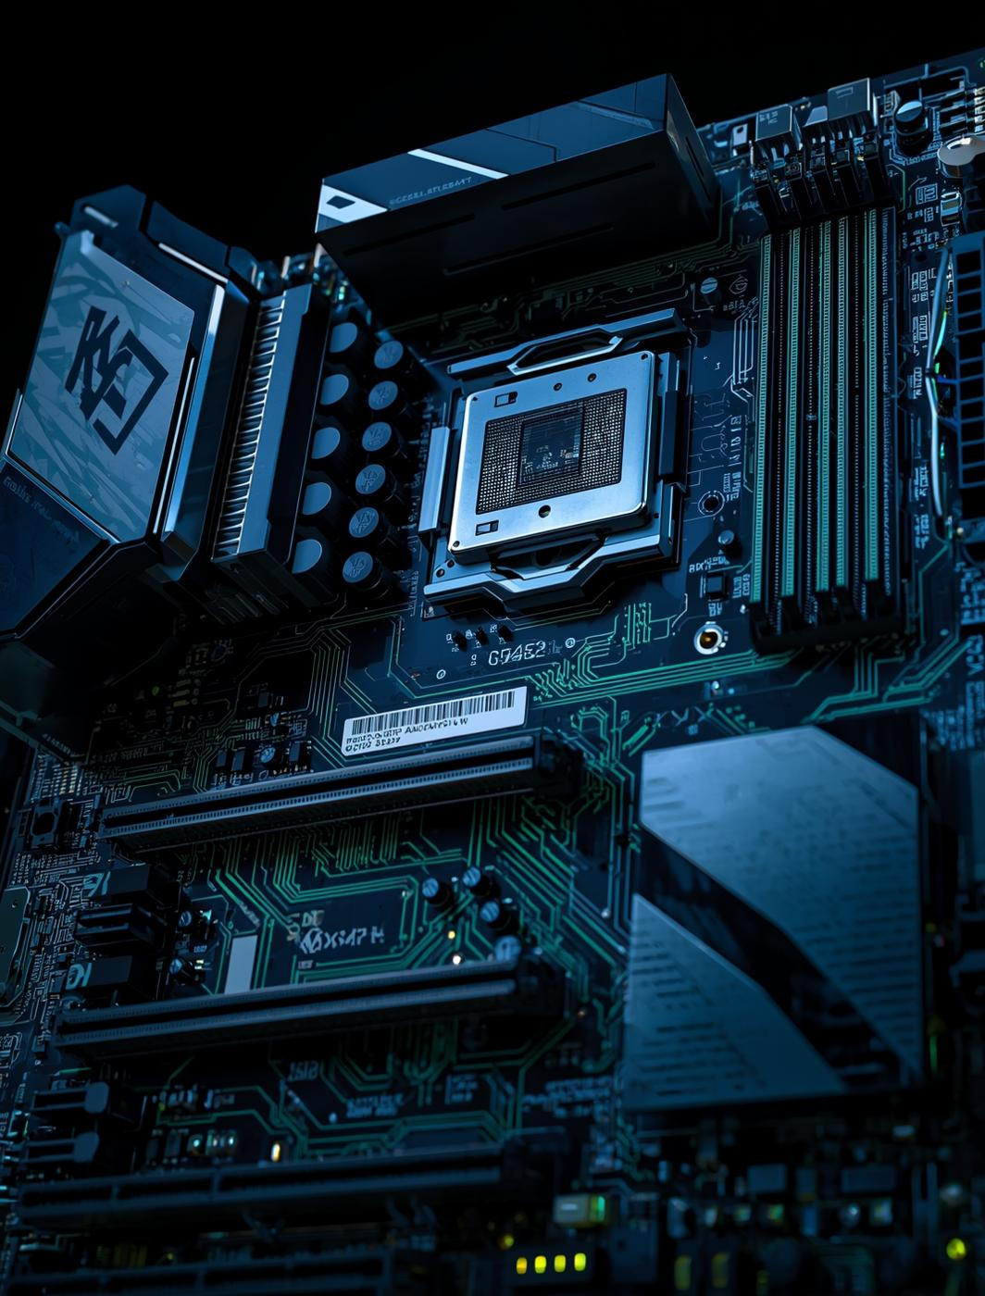
3 GHz
A 3 GHz CPU processes approximately 3 billion instructions per second, significantly impacting overall system performance and responsiveness across various applications and tasks.

Slide 7
3.5 GHz
Typical CPU speed today
50%
Increase in efficiency
8 cores
Common in modern CPUs

Slide 8
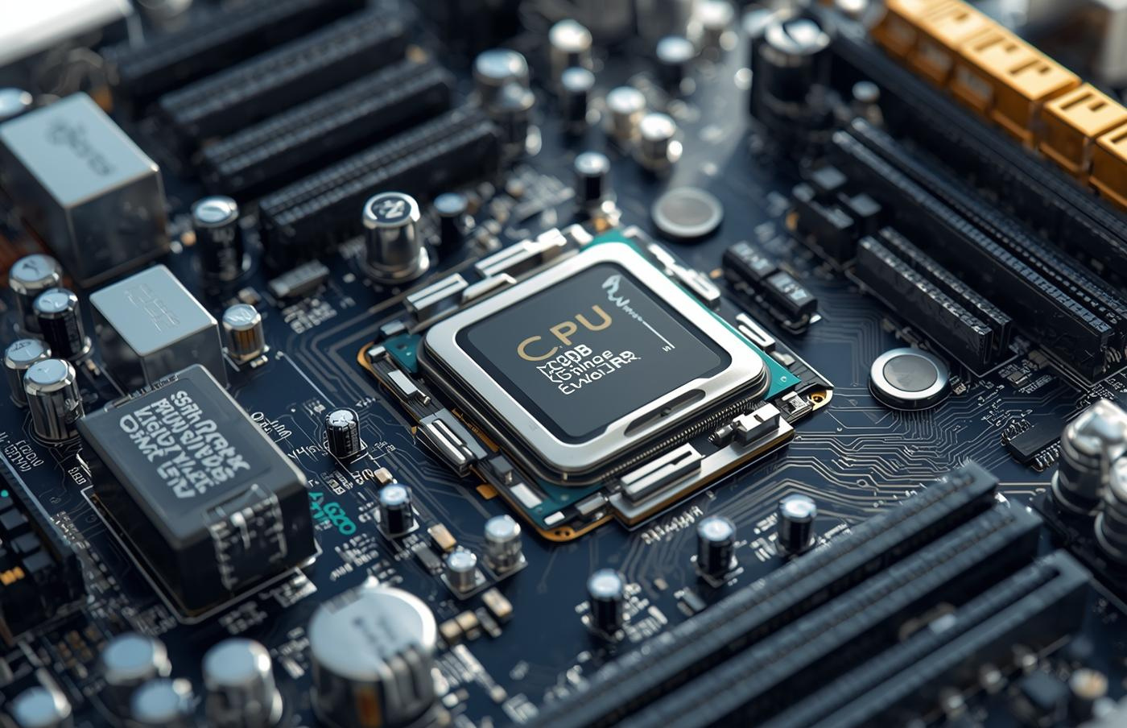
Importance of the CPU in Computer Systems
Central Decision-Maker
The CPU executes all tasks and manages essential operations.

Slide 9
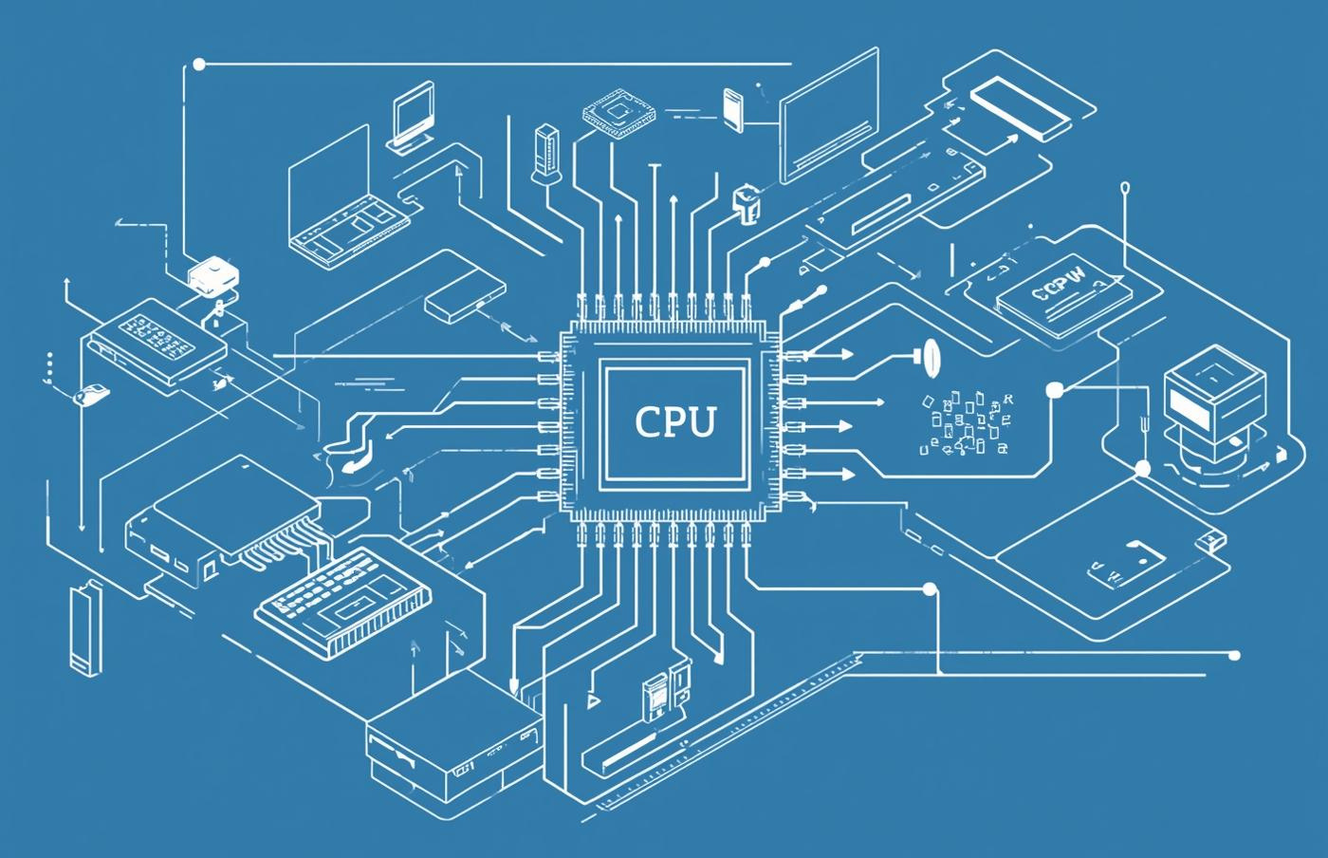
CPU's Role in Computer Systems
Processing Hub
The CPU coordinates all tasks within the computer system.

Slide 10
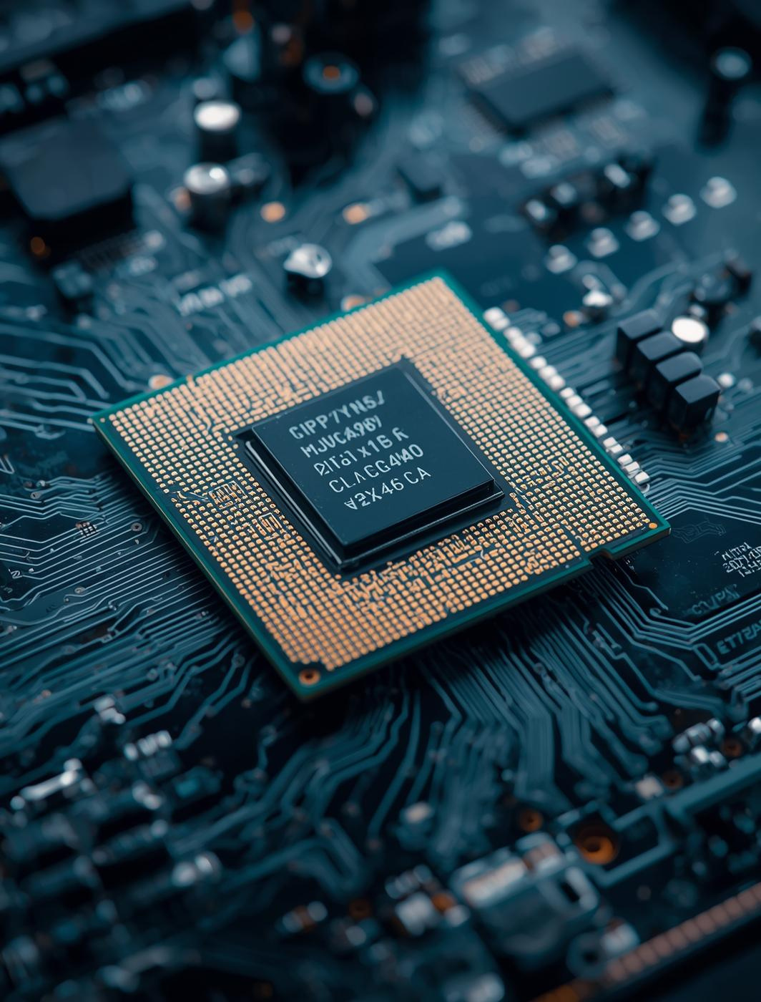
Summary of Key Takeaways
Understanding the CPU's Role in Modern Computing Systems
The Central Processing Unit (CPU) is the brain of the computer, consisting primarily of the Control Unit and the Arithmetic Logic Unit. CPU speed, measured in gigahertz, is a crucial factor in performance. Understanding these components and functions helps grasp the essential role CPUs play in executing tasks and managing hardware effectively.

Slide 11
Contact
Seofch Acedamy

